Slide 1
Stock Ticker Sprint 1
Nird
Patrick Gallagher, spencer Russell, tianyi zhang, hank zhu

Slide 2
Beginning of the Sprint
Design for the Frames
User Stories:
  GUI
  API

Slide 3
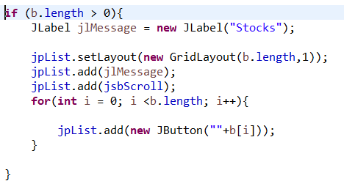
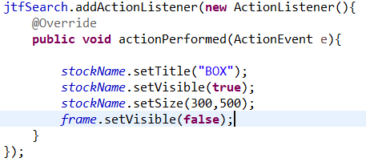
Menu Frame
ActionListener to the next frame
Four Panels
  Login Information
  Search Textfield
  Added Stocks
  Description of the added stocks

Slide 4
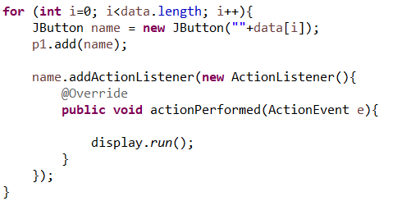
Searched Stocks
Used an array that has all of the stocks names that the user have searched
For loop to make all of the buttons in the array
ActionListener that goes to the next frame that gives the description of the selected stock

Slide 5
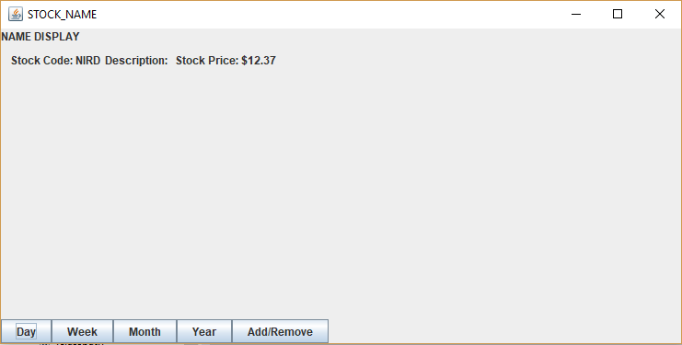
Stock Display
This portion of the GUI will display Stock information
The empty portion to the right will be populated with a dynamic graph formed by the data retrieved from the API
This will help the consumer research a stock prior to adding it to their personal list, as well as give them the option to add or remove the stock.

Slide 6
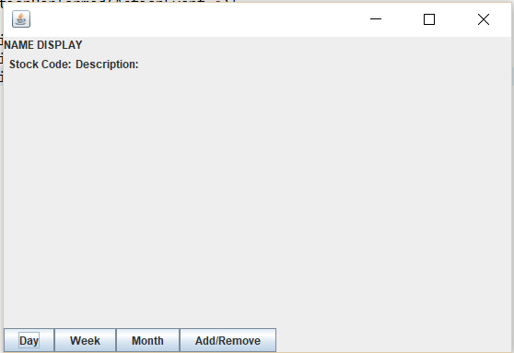
Stock Description (Future Sprint)
Locations for displaying the information from the API
Graph display to be implemented in the future sprint
Buttons serve the functionality of changing the graph and adding to the user’s list

Slide 7
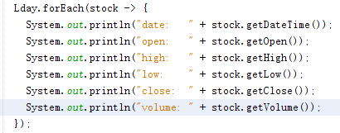
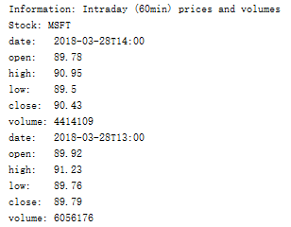
AlphaVantage Wrapper(Json parser)
Java output
Json output
: {
"2018-03-29 09:36:00": {
"1. open": "89.8800",
"2. high": "89.9400",
"3. low": "89.7300",
"4. close": "89.7300",
"5. volume": "137126"
},
"2018-03-29 09:35:00": {
"1. open": "89.8550",
"2. high": "89.9000",
"3. low": "89.7800",
"4. close": "89.8800",
"5. volume": "48321"
},

Slide 8
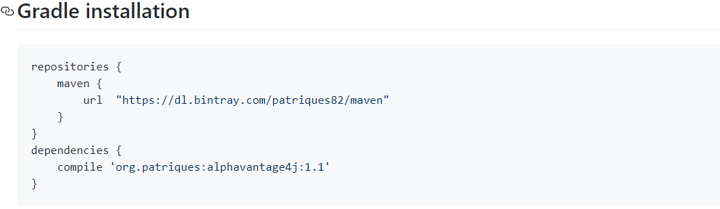
Apply api key https://www.alphavantage.co/

Slide 9
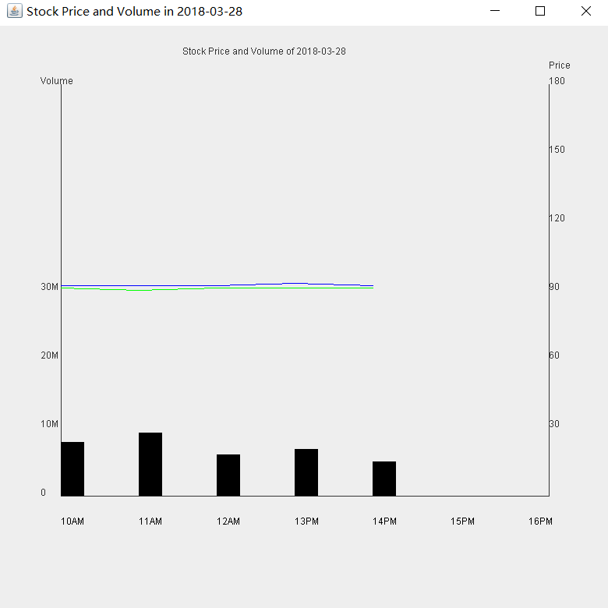

Slide 10
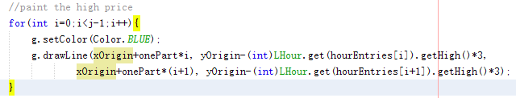
paintComponent()

Slide 11
Next Sprint
New User Stories
  Data Displays
  Search function that parses from the stocks
  Add the favorited stocks

